Slide 1
Design Exercise Knowledge Check: 2 Regions, 2 Clouds
ACE Solutions Architecture Team

Slide 2
Globex Corp: Business Objectives
Globex Corp uses GCP and Azure
They are running production and test workloads in Frankfurt and Singapore regions
The goal is that prod applications have high-quality links (low latency) to provide the best customer experience for the end users
Sensitive data is exchanged, so the traffic needs to be perfectly secure to protect the end user information

Slide 3
Globex Corp: Cloud Architecture Requirements
Let’s design the cloud network architecture for Globex, given the following requirements:
PROD and TEST need to be segmented
PROD and TEST need to have access to the Shared Services VNet
All the traffic between networks needs to be encrypted
Traffic going between PROD networks needs to be inspected by a Firewall, with intrusion detection.
Lowest latency possible should be the goal always
Validation
How would you validate that prod and test are segmented?
What are the expected routing tables at vpc route table, spoke and transit gateways for different segments?
How can you check traffic between Test and a server in Shared Services in last hour?
FRA-Prod-AKS is reporting high latency when accessing SIN-GKE-PROD. What can be some things to look at to find the issue?

Slide 4
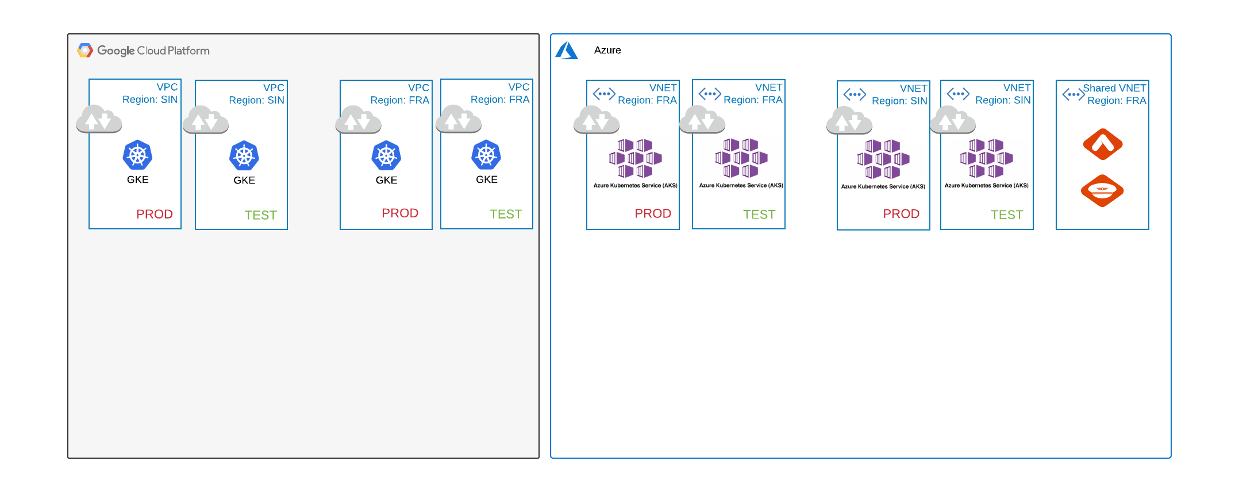
Design Template
PROD and TEST need to be segmented
PROD and TEST need to have access to the Shared Services VNet
All the traffic between networks needs to be encrypted
Traffic going between PROD networks needs to be inspected by an NGFW
Lowest latency possible should be the goal always

